Slide 1
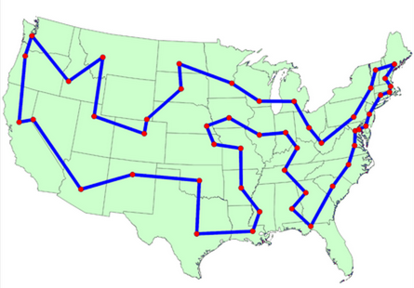
Introduction to Asymptotic Analysis
Lecture 13
CS Math 61B, Fall 2023 @ UC Berkeley
Slides credit: Josh Hug

Slide 2
Goal: Measuring Code Efficiency
Goal: Measuring Code Efficiency
Intuitive Runtime Characterizations
Clock Time
Exact Operation Counting
Exact Count Exercise
Asymptotic Analysis
Why Scaling Matters
Computing Worst Case Order of Growth (Tedious Approach)
Computing Worst Case Order of Growth (Simplified Approach)
Asymptotic Notation
Big Theta (a.k.a. Order of Growth)
Big O and Big Omega
Lecture 13, CS61B, Fall 2023

Slide 3
61B: Writing Efficient Programs
An engineer will do for a dime what any fool will do for a dollar.
Efficiency comes in two flavors:
Programming cost (course to date. Will also revisit later).
How long does it take to develop your programs?
How easy is it to read, modify, and maintain your code?
More important than you might think!
Majority of cost is in maintenance, not development!
Execution cost (from today until end of course).
How much time does your program take to execute?
How much memory does your program require?

Slide 4
Example of Algorithm Cost
Objective: Determine if a sorted array contains any duplicates.
Given sorted array A, are there indices i != j where A[i] == A[j]?
-3 | -1 | 2 | 4 | 4 | 8 | 10 | 12

Slide 5
Example of Algorithm Cost
Objective: Determine if a sorted array contains any duplicates.
Given sorted array A, are there indices i != j where A[i] == A[j]?
-3 | -1 | 2 | 4 | 4 | 8 | 10 | 12
Silly algorithm: Consider every possible pair, returning true if any match.
Are (-3, -1) the same? Are (-3, 2) the same? ...
Better algorithm?

Slide 6
Example of Algorithm Cost
Objective: Determine if a sorted array contains any duplicates.
Given sorted array A, are there indices i != j where A[i] == A[j]?
-3 | -1 | 2 | 4 | 4 | 8 | 10 | 12
Silly algorithm: Consider every possible pair, returning true if any match.
Are (-3, -1) the same? Are (-3, 2) the same? ...
Better algorithm?
For each number A[i], look at A[i+1], and return true the first time you see a match. If you run out of items, return false.
Today’s goal: Introduce formal technique for comparing algorithmic efficiency.

Slide 7
Clock Time
Goal: Measuring Code Efficiency
Intuitive Runtime Characterizations
Clock Time
Exact Operation Counting
Exact Count Exercise
Asymptotic Analysis
Why Scaling Matters
Computing Worst Case Order of Growth (Tedious Approach)
Computing Worst Case Order of Growth (Simplified Approach)
Asymptotic Notation
Big Theta (a.k.a. Order of Growth)
Big O and Big Omega
Lecture 13, CS61B, Fall 2023

Slide 8
How Do I Runtime Characterization?
Our goal is to somehow characterize the runtimes of the functions below.
Characterization should be simple and mathematically rigorous.
Characterization should demonstrate superiority of dup2 over dup1.
public static boolean dup1(int[] A) {
for (int i = 0; i < A.length; i += 1) {
for (int j = i + 1; j < A.length; j += 1) {
if (A[i] == A[j]) {
return true;
}
}
}
return false;
}
dup2
public static boolean dup2(int[] A) {
for (int i = 0; i < A.length - 1; i += 1) {
if (A[i] == A[i + 1]) {
return true;
}
}
return false;
}
dup1

Slide 9
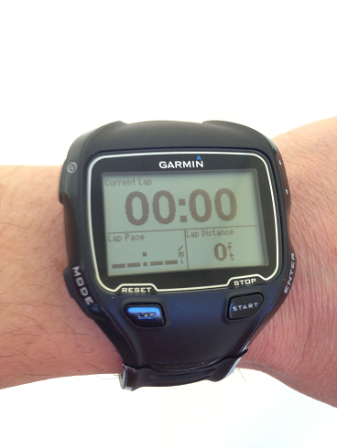
Techniques for Measuring Computational Cost
Technique 1: Measure execution time in seconds using a client program.
Tools:
Physical stopwatch.
Unix has a built in time command that measures execution time.
Princeton Standard library has a Stopwatch class.
public static void main(String[] args) {
int N = Integer.parseInt(args[0]);
int[] A = makeArray(N);
dup1(A);
}

Slide 10
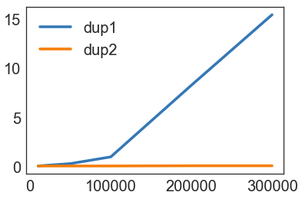
Time Measurements for dup1 and dup2
N | dup1 | dup2
10000 | 0.08 | 0.08
50000 | 0.32 | 0.08
100000 | 1.00 | 0.08
200000 | 8.26 | 0.1
400000 | 15.4 | 0.1
Time to complete (in seconds)

Slide 11
Techniques for Measuring Computational Cost
Technique 1: Measure execution time in seconds using a client program.
Good: Easy to measure, meaning is obvious.
Bad: May require large amounts of computation time. Result varies with machine, compiler, input data, programming language, etc.
Interesting observation: If you double the size of
the input, dup1 takes ~4x longer, while dup2 takes
~2x longer. True regardless of language and
machine.
public static void main(String[] args) {
int N = Integer.parseInt(args[0]);
int[] A = makeArray(N);
dup1(A);
}

Slide 12
Exact Operation Counting
Goal: Measuring Code Efficiency
Intuitive Runtime Characterizations
Clock Time
Exact Operation Counting
Exact Count Exercise
Asymptotic Analysis
Why Scaling Matters
Computing Worst Case Order of Growth (Tedious Approach)
Computing Worst Case Order of Growth (Simplified Approach)
Asymptotic Notation
Big Theta (a.k.a. Order of Growth)
Big O and Big Omega
Lecture 13, CS61B, Fall 2023

Slide 13
Techniques for Measuring Computational Cost
Technique 2A: Count possible operations for an array of size N = 10,000.
Good: Machine independent. Input dependence captured in model.
Bad: Tedious to compute. Array size was arbitrary. Doesn’t tell you actual time.
for (int i = 0; i < A.length; i += 1) {
for (int j = i+1; j < A.length; j += 1) {
if (A[i] == A[j]) {
return true;
}
}
}
return false;
operation | count, N=10000
i = 0
j = i + 1
less than (<)
increment (+=1)
equals (==)
array accesses
1
1 to 10000
2 to 50,015,001
0 to 50,005,000
1 to 49,995,000
2 to 99,990,000
The counts are tricky to compute. Work not shown.

Slide 14
Techniques for Measuring Computational Cost
Technique 2B: Count possible operations in terms of input array size N.
Good: Machine independent. Input dependence captured in model. Tells you how algorithm scales.
Bad: Even more tedious to compute. Doesn’t tell you actual time.
for (int i = 0; i < A.length; i += 1) {
for (int j = i+1; j<A.length; j += 1) {
if (A[i] == A[j]) {
return true;
}
}
}
return false;
operation | symbolic count | count, N=10000
i = 0 | 1 | 1
j = i + 1 | 1 to N | 1 to 10000
less than (<) | 2 to (N²+3N+2)/2 | 2 to 50,015,001
increment (+=1) | 0 to (N²+N)/2 | 0 to 50,005,000
equals (==) | 1 to (N²-N)/2 | 1 to 49,995,000
array accesses | 2 to N²-N | 2 to 99,990,000

Slide 15
Exact Count Exercise
Goal: Measuring Code Efficiency
Intuitive Runtime Characterizations
Clock Time
Exact Operation Counting
Exact Count Exercise
Asymptotic Analysis
Why Scaling Matters
Computing Worst Case Order of Growth (Tedious Approach)
Computing Worst Case Order of Growth (Simplified Approach)
Asymptotic Notation
Big Theta (a.k.a. Order of Growth)
Big O and Big Omega
Lecture 13, CS61B, Fall 2023

Slide 16
Techniques for Measuring Computational Cost [dup2]
Your turn: Try to come up with rough estimates for the symbolic and exact counts for at least one of the operations.
Tip: Don’t worry about being off by one. Just try to predict the rough magnitudes of each.
operation | sym. count | count, N=10000
i = 0 | 1 | 1
less than (<)
increment (+=1)
equals (==)
array accesses
for (int i = 0; i < A.length - 1; i += 1){
if (A[i] == A[i + 1]) {
return true;
}
}
return false;

Slide 17
Techniques for Measuring Computational Cost [dup2]
Your turn: Try to come up with rough estimates for the symbolic and exact counts for at least one of the operations.
An earlier version of this slide incorrectly stated that the number of < operations could be zero.
for (int i = 0; i < A.length - 1; i += 1) {
if (A[i] == A[i + 1]) {
return true;
}
}
return false;
operation | symbolic count | count, N=10000
i = 0 | 1 | 1
less than (<) | 1 to N | 0 to 10000
increment (+=1) | 0 to N - 1 | 0 to 9999
equals (==) | 1 to N - 1 | 1 to 9999
array accesses | 2 to 2N - 2 | 2 to 19998
Especially observant folks may notice we didn’t count everything, e.g. “- 1” and “+ 1” operations. We’ll see why this omission is not a problem very shortly.
If you did this exercise but were off by one, that’s fine. The exact numbers aren’t that important.

Slide 18
Why Scaling Matters
Goal: Measuring Code Efficiency
Intuitive Runtime Characterizations
Clock Time
Exact Operation Counting
Exact Count Exercise
Asymptotic Analysis
Why Scaling Matters
Computing Worst Case Order of Growth (Tedious Approach)
Computing Worst Case Order of Growth (Simplified Approach)
Asymptotic Notation
Big Theta (a.k.a. Order of Growth)
Big O and Big Omega
Lecture 13, CS61B, Fall 2023

Slide 19
Comparing Algorithms
Which algorithm is better? Why?
operation | symbolic count | count, N=10000
i = 0 | 1 | 1
j = i + 1 | 1 to N | 1 to 10000
less than (<) | 2 to (N²+3N+2)/2 | 2 to 50,015,001
increment (+=1) | 0 to (N²+N)/2 | 0 to 50,005,000
equals (==) | 1 to (N²-N)/2 | 1 to 49,995,000
array accesses | 2 to N²-N | 2 to 99,990,000
operation | symbolic count | count, N=10000
i = 0 | 1 | 1
less than (<) | 0 to N | 0 to 10000
increment (+=1) | 0 to N - 1 | 0 to 9999
equals (==) | 1 to N - 1 | 1 to 9999
array accesses | 2 to 2N - 2 | 2 to 19998
dup2
dup1

Slide 20
Comparing Algorithms
Which algorithm is better? dup2. Why?
Fewer operations to do the same work [e.g. 50,015,001 vs. 10000 operations].
Better answer: Algorithm scales better in the worst case. (N²+3N+2)/2 vs. N.
Even better answer: Parabolas (N²) grow faster than lines (N).
operation | symbolic count | count, N=10000
i = 0 | 1 | 1
j = i + 1 | 1 to N | 1 to 10000
less than (<) | 2 to (N²+3N+2)/2 | 2 to 50,015,001
increment (+=1) | 0 to (N²+N)/2 | 0 to 50,005,000
equals (==) | 1 to (N²-N)/2 | 1 to 49,995,000
array accesses | 2 to N²-N | 2 to 99,990,000
operation | symbolic count | count, N=10000
i = 0 | 1 | 1
less than (<) | 0 to N | 0 to 10000
increment (+=1) | 0 to N - 1 | 0 to 9999
equals (==) | 1 to N - 1 | 1 to 9999
array accesses | 2 to 2N - 2 | 2 to 19998
dup2
dup1

Slide 21
Asymptotic Behavior
In most cases, we care only about asymptotic behavior, i.e. what happens for very large N.
Simulation of billions of interacting particles.
Social network with billions of users.
Logging of billions of transactions.
Encoding of billions of bytes of video data.
Algorithms which scale well (e.g. look like lines) have better asymptotic runtime behavior than algorithms that scale relatively poorly (e.g. look like parabolas).

Slide 22
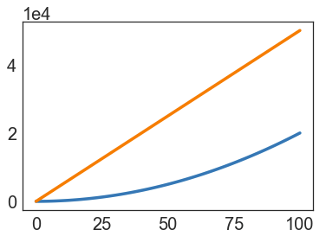
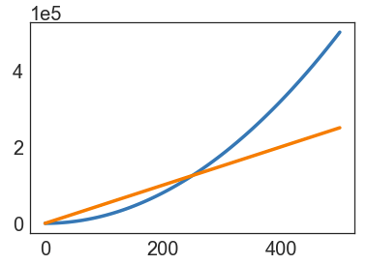
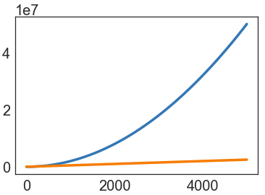
Parabolas vs. Lines
Suppose we have two algorithms that zerpify a collection of N items.
zerp1 takes 2N² operations.
zerp2 takes 500N operations.
For small N, zerp1 might be faster, but as dataset size grows, the parabolic algorithm is going to fall farther and farther behind (in time it takes to complete).

Slide 23
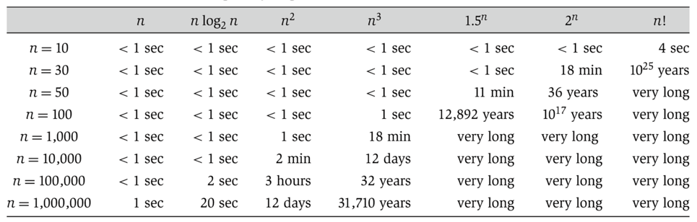

Scaling Across Many Domains
We’ll informally refer to the “shape” of a runtime function as its order of growth (will formalize soon).
Effect is dramatic! Often determines whether a problem can be solved at all.
(from Algorithm Design: Tardos, Kleinberg)

Slide 24


Duplicate Finding
Our goal is to somehow characterize the runtimes of the functions below.
Characterization should be simple and mathematically rigorous.
Characterization should demonstrate superiority of dup2 over dup1.
operation | symbolic count
i = 0 | 1
j = i + 1 | 1 to N
less than (<) | 2 to (N²+3N+2)/2
increment (+=1) | 0 to (N²+N)/2
equals (==) | 1 to (N²-N)/2
array accesses | 2 to N²-N
operation | symbolic count
i = 0 | 1
less than (<) | 0 to N
increment (+=1) | 0 to N - 1
equals (==) | 1 to N - 1
array accesses | 2 to 2N - 2
dup1: parabolic, a.k.a. quadratic
dup2: linear

Slide 25
Computing Worst Case Order of Growth (Tedious Approach)
Goal: Measuring Code Efficiency
Intuitive Runtime Characterizations
Clock Time
Exact Operation Counting
Exact Count Exercise
Asymptotic Analysis
Why Scaling Matters
Computing Worst Case Order of Growth (Tedious Approach)
Computing Worst Case Order of Growth (Simplified Approach)
Asymptotic Notation
Big Theta (a.k.a. Order of Growth)
Big O and Big Omega
Lecture 13, CS61B, Fall 2023

Slide 26
Duplicate Finding
Our goal is to somehow characterize the runtimes of the functions below.
Characterization should be simple and mathematically rigorous.
operation | count
i = 0 | 1
j = i + 1 | 1 to N
less than (<) | 2 to (N²+3N+2)/2
increment (+=1) | 0 to (N²+N)/2
equals (==) | 1 to (N²-N)/2
array accesses | 2 to N²-N
operation | count
i = 0 | 1
less than (<) | 0 to N
increment (+=1) | 0 to N - 1
equals (==) | 1 to N - 1
array accesses | 2 to 2N - 2
Let’s be more careful about what we mean when we say the left function is “like” a parabola, and the right function is “like” a line.

Slide 27
Intuitive Simplification 1: Consider Only the Worst Case
Simplification 1: Consider only the worst case.
operation | count
i = 0 | 1
j = i + 1 | 1 to N
less than (<) | 2 to (N²+3N+2)/2
increment (+=1) | 0 to (N²+N)/2
equals (==) | 1 to (N²-N)/2
array accesses | 2 to N²-N
for (int i = 0; i < A.length; i += 1) {
for (int j = i+1; j < A.length; j += 1) {
if (A[i] == A[j]) {
return true;
}
}
}
return false;

Slide 28
Intuitive Simplification 1: Consider Only the Worst Case
Simplification 1: Consider only the worst case.
Justification: When comparing algorithms, we often care only about the worst case [but we will see exceptions in this course].
operation | worst case count
i = 0 | 1
j = i + 1 | N
less than (<) | (N²+3N+2)/2
increment (+=1) | (N²+N)/2
equals (==) | (N²-N)/2
array accesses | N²-N
for (int i = 0; i < A.length; i += 1) {
for (int j = i+1; j < A.length; j += 1) {
if (A[i] == A[j]) {
return true;
}
}
}
return false;
We’re effectively focusing on the case where there are no duplicates, because this is where there is a performance difference.

Slide 29
Intuitive Order of Growth Identification: yellkey.com/outside
Consider the algorithm below. What do you expect will be the order of growth of the runtime for the algorithm?
N [linear]
N² [quadratic]
N³ [cubic]
N⁶ [sextic]
operation | count
less than (<) | 100N² + 3N
greater than (>) | 2N³ + 1
and (&&) | 5,000
In other words, if we plotted total runtime vs. N, what shape would we expect?

Slide 30
Intuitive Order of Growth Identification
Consider the algorithm below. What do you expect will be the order of growth of the runtime for the algorithm?
N [linear]
N² [quadratic]
N³ [cubic]
N⁶ [sextic]
operation | count
less than (<) | 100N² + 3N
greater than (>) | 2N³ + 1
and (&&) | 5,000
Argument:
Suppose < takes α nanoseconds, > takes β nanoseconds, and && takes γ nanoseconds.
Total time is α(100N² + 3N) + β(2N³ + 1) + 5000γ nanoseconds.
For very large N, the 2βN³ term is much larger than the others.
Extremely important point. Make sure you understand it!

Slide 31
Intuitive Simplification 2: Eliminate low order terms
Simplification 2: Ignore lower order terms
Eventually, 0.000000000001N^{2.00000001} will grow bigger than 10000000000N²
So for sufficiently large N, only the largest term will actually matter
operation | worst case count
i = 0 | 1
j = i + 1 | N
less than (<) | (N²+3N+2)/2
increment (+=1) | (N²+N)/2
equals (==) | (N²-N)/2
array accesses | N²-N
for (int i = 0; i < A.length; i += 1) {
for (int j = i+1; j < A.length; j += 1) {
if (A[i] == A[j]) {
return true;
}
}
}
return false;

Slide 32
(Not as) Intuitive Simplification 3: Eliminate multiplicative constants
Simplification 3: Ignore any coefficients
Coefficients don't affect the "shape" of the function
Often can change depending on what you consider "one operation"
There are some branches of runtime analysis which care about coefficients. But it's much harder, because…
operation | worst case count
i = 0 | 1
j = i + 1 | N
less than (<) | N²/2
increment (+=1) | N²/2
equals (==) | N²/2
array accesses | N²
for (int i = 0; i < A.length; i += 1) {
for (int j = i+1; j < A.length; j += 1) {
if (A[i] == A[j]) {
return true;
}
}
}
return false;

Slide 33
Intuitive Simplification 4: Combine all operations
Simplification 4: Treat all operations as taking "1 unit of time"
Even if an increment takes 1 ns and an array access takes 1000000 ns, those are still basically coefficients
Also lets as pick what we count as a "primitive" operation arbitrarily
Assumes that operations (ex. addition) take constant time regardless of input; this is known as the "cost model".
operation | worst case count
i = 0 | 1
j = i + 1 | N
less than (<) | N²
increment (+=1) | N²
equals (==) | N²
array accesses | N²
for (int i = 0; i < A.length; i += 1) {
for (int j = i+1; j < A.length; j += 1) {
if (A[i] == A[j]) {
return true;
}
}
}
return false;

Slide 34
Intuitive Simplification 4: Eliminate multiplicative constants.
Simplification 4: Ignore multiplicative constants.
Why? It has no real meaning. We already threw away information when we chose a single proxy operation.
for (int i = 0; i < A.length; i += 1) {
for (int j = i+1; j < A.length; j += 1) {
if (A[i] == A[j]) {
return true;
}
}
}
return false;
operation | worst case
Total | N²

Slide 35
Simplification Summary
Simplifications:
Only consider the worst case.
Ignore lower order terms.
Ignore any coefficients.
All operations take the same time.
operation | count
i = 0 | 1
j = i + 1 | 1 to N
less than (<) | 2 to (N²+3N+2)/2
increment (+=1) | 0 to (N²+N)/2
equals (==) | 1 to (N²-N)/2
array accesses | 2 to N²-N
These three simplifications are OK because we only care about the “order of growth” of the runtime.
operation | worst case o.o.g.
Total | N²
Worst case order of growth of runtime: N²

Slide 36
Simplification Summary: Repeating the Process for dup2
Simplifications:
Only consider the worst case.
Ignore lower order terms.
Ignore any coefficients.
All operations take the same time.
operation | count
i = 0 | 1
less than (<) | 0 to N
increment (+=1) | 0 to N - 1
equals (==) | 1 to N - 1
array accesses | 2 to 2N - 2
These three simplifications are OK because we only care about the “order of growth” of the runtime.
operation | worst case o.o.g.
Worst case order of growth of runtime:

Slide 37
Repeating the Process for dup2
Simplifications:
Only consider the worst case.
Ignore lower order terms.
Ignore any coefficients.
All operations take the same time.
This simplification is OK because we specifically only care about worst case.
operation | count
i = 0 | 1
less than (<) | 0 to N
increment (+=1) | 0 to N - 1
equals (==) | 1 to N - 1
array accesses | 2 to 2N - 2
These three simplifications are OK because we only care about the “order of growth” of the runtime.
operation | worst case o.o.g.
Total | N
Worst case order of growth of runtime: N

Slide 38
Summary of Our (Painful) Analysis Process
One thing to note: If N -> N², then 2N -> (2N)² = 4N²; doubling the size of the input means 4x longer runtime
This is what we observed earlier! So despite all our simplifications, this theoretical analysis matches our experimental values.
operation | count
i = 0 | 1
j = i + 1 | 1 to N
less than (<) | 2 to (N²+3N+2)/2
increment (+=1) | 0 to (N²+N)/2
equals (==) | 1 to (N²-N)/2
array accesses | 2 to N²-N
operation | worst case o.o.g.
Total | N²
Worst case order of growth of runtime: N²

Slide 39
Summary of Our (Painful) Analysis Process
Our process:
Construct a table of exact counts of all possible operations.
Convert table into a worst case order of growth using 4 simplifications.
By using our simplifications from the outset, we can avoid building the table at all!
operation | count
i = 0 | 1
j = i + 1 | 1 to N
less than (<) | 2 to (N²+3N+2)/2
increment (+=1) | 0 to (N²+N)/2
equals (==) | 1 to (N²-N)/2
array accesses | 2 to N²-N
operation | worst case o.o.g.
Total | N²
Worst case order of growth of runtime: N²

Slide 40
Computing Worst Case Order of Growth (Simplified Approach)
Goal: Measuring Code Efficiency
Intuitive Runtime Characterizations
Clock Time
Exact Operation Counting
Exact Count Exercise
Asymptotic Analysis
Why Scaling Matters
Computing Worst Case Order of Growth (Tedious Approach)
Computing Worst Case Order of Growth (Simplified Approach)
Asymptotic Notation
Big Theta (a.k.a. Order of Growth)
Big O and Big Omega
Lecture 13, CS61B, Fall 2023

Slide 41
Simplified Analysis Process
Rather than building the entire table, we can instead:
Treat anything that takes constant time (relative to N) as a single operation
Figure out the order of growth for the count of that operation by either:
Making an exact count, then discarding the unnecessary pieces.
Using intuition and inspection to determine order of growth (only possible with lots of practice).
Let’s redo our analysis of dup1 with this new process.
This time, we’ll show all our work.

Slide 42
Analysis of Nested For Loops (Based on Exact Count)
Find the order of growth of the worst case runtime of dup1.
int N = A.length;
for (int i = 0; i < N; i += 1)
for (int j = i + 1; j < N; j += 1)
if (A[i] == A[j])
return true;
return false;
Overall worst case runtime: Θ(N²)

Slide 43
Analysis of Nested For Loops (Based on Exact Count)
Find the order of growth of the worst case runtime of dup1.
int N = A.length;
for (int i = 0; i < N; i += 1)
for (int j = i + 1; j < N; j += 1)
//1 unit of time
return false;
Overall worst case runtime: Θ(N²)

Slide 44
Analysis of Nested For Loops (Based on Exact Count)
Find the order of growth of the worst case runtime of dup1.
N = 6
int N = A.length;
for (int i = 0; i < N; i += 1)
for (int j = i + 1; j < N; j += 1)
//1 unit of time
return false;
0
1
2
3
4
5
 | 1 | 1 | 1 | 1 | 1
 |  | 1 | 1 | 1 | 1
 |  |  | 1 | 1 | 1
 |  |  |  | 1 | 1
 |  |  |  |  | 1
i
Worst case number of steps:
C = 1 + 2 + 3 + … + (N - 3) + (N - 2) + (N - 1)
0 1 2 3 4 5
C = (N - 1) + (N - 2) + (N - 3) + … + 3 + 2 + 1
j
2C = N + N + … + N
= N(N - 1)
N-1 of these
∴ C = N(N - 1)/2
Overall worst case runtime: Θ(N²)

Slide 45
Analysis of Nested For Loops (Based on Exact Count)
Find the order of growth of the worst case runtime of dup1.
N = 6
int N = A.length;
for (int i = 0; i < N; i += 1)
for (int j = i + 1; j < N; j += 1)
//1 unit of time
return false;
0
1
2
3
4
5
 | 1 | 1 | 1 | 1 | 1
 |  | 1 | 1 | 1 | 1
 |  |  | 1 | 1 | 1
 |  |  |  | 1 | 1
 |  |  |  |  | 1
i
Worst case number of steps:
C = 1 + 2 + 3 + … + (N - 3) + (N - 2) + (N - 1) = N(N-1)/2
0 1 2 3 4 5
j
operation | worst case o.o.g.
== | N²
Worst case order of growth of runtime: N²
Overall worst case runtime: Θ(N²)

Slide 46
Analysis of Nested For Loops (Simpler Geometric Argument)
Find the order of growth of the worst case runtime of dup1.
N = 6
int N = A.length;
for (int i = 0; i < N; i += 1)
for (int j = i + 1; j < N; j += 1)
//1 unit of time
return false;
0
1
2
3
4
5
 | 1 | 1 | 1 | 1 | 1
 |  | 1 | 1 | 1 | 1
 |  |  | 1 | 1 | 1
 |  |  |  | 1 | 1
 |  |  |  |  | 1
i
Worst case number of steps:
Given by area of right triangle of side length N-1.
Order of growth of area is N².
0 1 2 3 4 5
j
operation | worst case o.o.g.
== | N²
Worst case order of growth of runtime: N²
Overall worst case runtime: Θ(N²)

Slide 47
Big Theta (a.k.a. Order of Growth)
Goal: Measuring Code Efficiency
Intuitive Runtime Characterizations
Clock Time
Exact Operation Counting
Exact Count Exercise
Asymptotic Analysis
Why Scaling Matters
Computing Worst Case Order of Growth (Tedious Approach)
Computing Worst Case Order of Growth (Simplified Approach)
Asymptotic Notation
Big Theta (a.k.a. Order of Growth)
Big O and Big Omega
Lecture 13, CS61B, Fall 2023

Slide 48
Formalizing Order of Growth
Given a function Q(N), we can apply our last two simplifications (ignore low orders terms and multiplicative constants) to yield the order of growth of Q(N).
Example: Q(N) = 3N³ + N²
Order of growth: N³
Let’s finish out this lecture by moving to a more formal notation called Big-Theta.
The math might seem daunting at first.
… but the idea is exactly the same! Using “Big-Theta” instead of “order of growth” does not change the way we analyze code at all.

Slide 49
Order of Growth Exercise
Consider the functions below.
Informally, what is the “shape” of each function for very large N?
In other words, what is the order of growth of each function?
function | order of growth
N³ + 3N⁴
1/N + N³
1/N + 5
Ne^{N} + N
40 sin(N) + 4N²

Slide 50
Order of Growth Exercise
Consider the functions below.
Informally, what is the “shape” of each function for very large N?
In other words, what is the order of growth of each function?
function | order of growth
N³ + 3N⁴ | N⁴
1/N + N³ | N³
1/N + 5 | 1
Ne^{N} + N | Ne^{N}
40 sin(N) + 4N² | N²

Slide 51
Big-Theta
Suppose we have a function R(N) with order of growth f(N).
In “Big-Theta” notation we write this as R(N) ∈ Θ(f(N)).
Examples:
N³ + 3N⁴ ∈ Θ(N⁴)
1/N + N³ ∈ Θ(N³)
1/N + 5 ∈ Θ(1)
Ne^{N} + N ∈ Θ(Ne^{N})
40 sin(N) + 4N² ∈ Θ(N²)
function R(N) | order of growth
N³ + 3N⁴ | N⁴
1/N + N³ | N³
1/N + 5 | 1
Ne^{N} + N | Ne^{N}
40 sin(N) + 4N² | N²

Slide 52
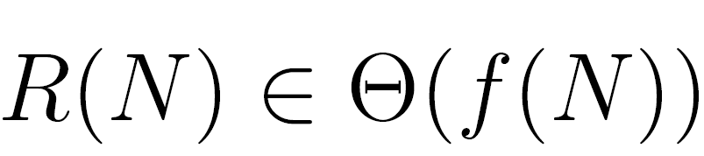
Big-Theta: Formal Definition (Visualization)
means there exist positive constants k₁ and k₂ such that:
for all values of N greater than some N₀.
i.e. very large N
Example: 40 sin(N) + 4N² ∈ Θ(N²)
R(N) = 40 sin(N) + 4N²
f(N) = N²
k1 = 3
k2 = 5

Slide 53
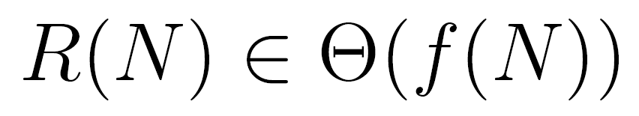
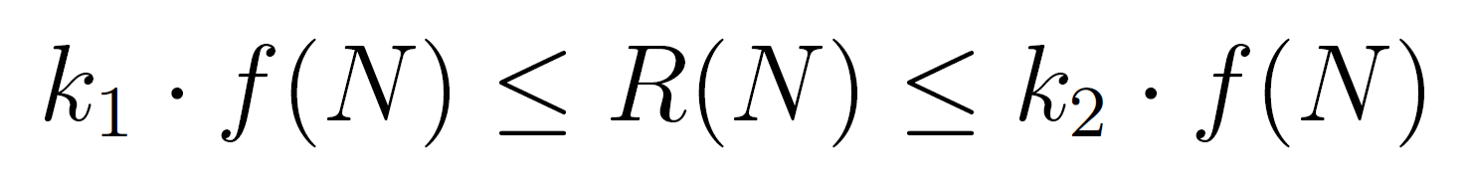
Big-Theta Challenge (Visualization)
Suppose R(N) = (4N²+3N*ln(N))/2.
Find a simple f(N) and corresponding k₁ and k₂.
means there exist positive constants k₁ and k₂ such that:
for all values of N greater than some N₀.
i.e. very large N

Slide 54
Big-Theta Challenge (Visualization)
Suppose R(N) = (4N²+3N*ln(N))/2.
f(N) = N²
k₁ = 1
k₂ = 3
means there exist positive constants k₁ and k₂ such that:
for all values of N greater than some N₀.
i.e. very large N

Slide 55
Big-Theta and Runtime Analysis
Using Big-Theta doesn’t change anything about runtime analysis (no need to find k₁ or k₂ or anything like that).
The only difference is that we use the Θ symbol anywhere we would have said “order of growth”.
operation | worst case count
i = 0 | 1
j = i + 1 | Θ(N)
less than (<) | Θ(N²)
increment (+=1) | Θ(N²)
equals (==) | Θ(N²)
array accesses | Θ(N²)
operation | worst case count
Total | Θ(N²)
Worst case runtime: Θ(N²)

Slide 56
Big O and Big Omega
Goal: Measuring Code Efficiency
Intuitive Runtime Characterizations
Clock Time
Exact Operation Counting
Exact Count Exercise
Asymptotic Analysis
Why Scaling Matters
Computing Worst Case Order of Growth (Tedious Approach)
Computing Worst Case Order of Growth (Simplified Approach)
Asymptotic Notation
Big Theta (a.k.a. Order of Growth)
Big O and Big Omega
Lecture 13, CS61B, Fall 2023

Slide 57
Big Theta
We used Big Theta to describe the order of growth of a function.
We also used Big Theta to describe the rate of growth of the runtime of a piece of code.
function R(N) | order of growth
N³ + 3N⁴ | Θ(N⁴)
1/N + N³ | Θ(N³)
1/N + 5 | Θ(1)
Ne^{N} + N | Θ(Ne^{N})
40 sin(N) + 4N² | Θ(N²)

Slide 58
Big O and Big Omega
Whereas Big Theta can informally be thought of as something like “equals”, Big O can be thought of as “less than or equal” and Big Omega can be thought of as "greater than or equal"
Example, the following are all true:
N³ + 3N⁴ ∈ Θ(N⁴)
N³ + 3N⁴ ∈ O(N⁴)
N³ + 3N⁴ ∈ O(N⁶)
N³ + 3N⁴ ∈ O(N^{N!})
N³ + 3N⁴ ∈ Ω(N⁴)
N³ + 3N⁴ ∈ Ω(N²)
N³ + 3N⁴ ∈ Ω(1)

Slide 59
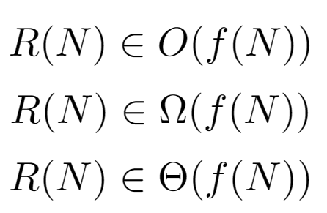
Big-Theta: Formal Definition
means there exist positive constants k₁ and k₂ such that:
for all values of N greater than some N₀.
i.e. very large N

Slide 60
Big O
means there exists a positive constant k₂ such that:
for all values of N greater than some N₀.
i.e. very large N

Slide 61
Big Omega
means there exists a positive constant k₁ such that:
for all values of N greater than some N₀.
i.e. very large N

Slide 62
Big Theta vs. Big O
We will see why big O is practically useful in the upcoming Disjoint Sets lecture.
 | Informal meaning: | Family | Family Members
Big Theta Θ(f(N)) | Order of growth is f(N). | Θ(N²) | N²/2 2N² N² + 38N + N
Big O O(f(N)) | Order of growth is less than or equal to f(N). | O(N²) | N²/2 2N² lg(N)
Big Omega Ω(f(N)) | Order of growth is greater than or equal to f(N). | Ω(N²) | N²/2 2N² N^{N!}

Slide 63
Summary
Given a code snippet, we can express its runtime as a function R(N), where N is some property of the input of the function (often the size of the input).
Rather than finding R(N) exactly, we instead usually only care about the order of growth of R(N).
One approach (not universal):
Reduce constant time operations to "1 unit of time", and let C(N) be the count of how many times that operation occurs as a function of N.
Determine order of growth f(N) for C(N), i.e. C(N) ∈ Θ(f(N))
Often (but not always) we consider the worst case count.
Can use O as an alternative for Θ. O is used for upper bounds. Ω isn't used often in practical settings, but is often used in theoretical CS for lower bounds.

Slide 64
Citations
TSP problem solution, title slide: http://support.sas.com/documentation/cdl/en/ornoaug/65289/HTML/default/viewer.htm#ornoaug_optnet_examples07.htm#ornoaug.optnet.map002g
Table of runtimes for various orders of growth: Kleinberg & Tardos, Algorithm Design.

